Slide 1
CASE STUDY · SMART LOGISTICS SERVICE OPTIMISATION · HSLU
How to stop smart bins from weighing themselves for nothing – without missing a pick
Bossard SmartBin Cloud · interim findings · the project explained step by step
Erenalp Çakıroğlu · MSc Applied Information and Data Science · 23 October 2026
Notes:
Welcome. This deck tells the SmartBin story from start to finish, for someone who has not seen the details. Bossard's SmartBin Cloud puts a battery-powered scale under every bin of small parts at a customer's site. A vibration sensor wakes the scale up when the bin is touched; the scale weighs and reports the stock level, and Bossard's ordering system ARIMS reorders automatically. The client's question: how should the sensitivity of that vibration sensor be set, so that the scales do not weigh for nothing, but also do not miss real picks? Our headline answer: there is no single right number. The right setting depends on where and how a bin is used, and that is not in the master data. So every scale should learn its own level from its own weekly results, with a simple rule that is reviewed every two weeks. In our simulation this cuts the weighings of normal scales by 55 to 61 percent, while the sensor still catches almost nine out of ten changes at once and the 24-hour check finds most of the rest within one to two days. A separate finding: in the data, 274 scales caught in a trigger loop – 1.5% of the scales – produced 27% of all automatic weighings, most of them during a four-week trial of level 3 in April 2022. That is a defect to repair, not a setting to tune. Every slide answers the question raised by the slide before it.

Slide 2
THE CLIENT
Bossard SmartBin Cloud: a scale under every bin
≈ 110,000 scales
Automatic reordering
A battery for ≥ 5 years
A sensor decides
installed at customer sites by March 2025; each reports the stock level of its bin. Our data: 18,455 of them.
the stock level flows into Bossard's ARIMS system, which orders new parts before a bin runs empty.
a weighing draws about 3,000 times the power of sleep mode and loads the radio network, the IoT cloud and ARIMS.
the scale sleeps until its vibration sensor reports a touch. The sensitivity (1–10, default 8) sets how strong it must be.
HOW A PICK BECOMES AN ORDER
Someone takes parts
Sensor wakes the scale
Scale weighs
Radio network
IoT cloud
ARIMS reorders
So: every unnecessary wake-up costs battery, radio and cloud capacity – and every change the sensor sleeps through leaves a wrong stock level in ARIMS.
Source: Bossard AG & D ONE (2026), case material; Bossard AG (n.d.); Anastasi et al. (2009)
2
Notes:
Who is the client? Bossard supplies fasteners and other small C-parts to industrial customers. SmartBin Cloud is its weight-based e-Kanban: every bin stands on a scale, the scale reports the stock level, and when it falls below the reorder level, ARIMS – Bossard's replenishment system – orders automatically. About 110,000 scales were installed by March 2025; our data cover 18,455 of them. The scales run on batteries that should last at least five years. A weighing consumes about 3,000 times the power of sleep mode, and every weighing also travels over the radio network and loads the IoT cloud and ARIMS. That is why the scale sleeps and only wakes up when its vibration sensor reports a touch. The sensitivity setting, from 1 to 10 with a factory default of 8, decides how strong that vibration must be. Two more settings exist – the minimum wait time and the measurement delay – but the case declared them out of scope. In the language of sensor networks this is event-driven duty cycling: a node saves energy by sleeping and waking only on events (Anastasi et al., 2009). The price of sleeping is that an event can be missed – and that is exactly the trade-off of this case.

Slide 3
THE PROBLEM
Every weighing ends in one of four outcomes
OK · weight changed: real pick caught
1.7 M
yes: the scale weighs at once (automatic)
TOO_MANY · no change: empty wake-up
5.4 M
Someone touches the bin
Is the vibration above the sensitivity threshold?
no: it sleeps on; a 24 h check or a person weighs later (manual)
TOO_FEW · change found later: missed
0.1 M
OK · no change: nothing missed
0.4 M
So: the setting moves one threshold. Too low wastes energy on empty wake-ups, too high misses changes – the classic false-alarm vs. miss trade-off of every detector.
Bossard's KPIs per scale
TOO_MANY fraction = TOO_MANY / all automatic weighings · target ≤ 0.5 · alarm > 0.8
TOO_FEW per week · target ≤ 2
Source: Bossard AG & D ONE (2026); Green & Swets (1966). Counts after removing duplicates and impossible weights (M = million).
3
Notes:
Every weighing in the data ends in one of four outcomes, and the whole project is built on them. If the sensor wakes the scale up, we have an automatic weighing: either the weight has changed – a real pick was caught, labelled OK – or it has not – an empty wake-up, labelled TOO_MANY. If the sensor sleeps through a change, the change is only found later by a manual weighing: either a person triggers it, or – in 85% of the cases – a check that runs when a scale has been idle for about 24 hours. If that weighing finds a change, it is labelled TOO_FEW: the sensor missed it. In the data, after removing duplicates and impossible weights: 1.7 million caught picks, 5.4 million empty wake-ups – 76% of all automatic weighings – 0.4 million manual weighings without a change and 0.1 million missed changes. Bossard measures two KPIs per scale: the share of empty wake-ups among all automatic weighings (target at most 0.5, alarm above 0.8) and the number of missed changes per week (target at most 2). This is the classic trade-off of any detector: a lower threshold produces more false alarms, a higher one more misses (Green & Swets, 1966). The sensitivity setting moves that threshold. Keep one thing in mind for later: TOO_FEW can only come from a manual weighing, so it is a lower bound of the misses.

Slide 4
OUR APPROACH
The client's three questions
1
2
3
Which parameters hardly matter?
Which parameters matter?
How should the sensitivity be set?
What we did: measured sites, usage and timing – and the setting itself on the 7,846 scales Bossard switched in April.
What we did: compared groups of scales on the same setting (level 8).
What we did: simulated nine policies on the real history of every scale.
Short answer: box type and item weight – clearly on 20 kg, less so on 6 kg scales.
Short answer: not one number – each scale learns its level, after defects are repaired.
Short answer: site and usage – and the setting, the only lever Bossard controls remotely.
Data: 3 files
Clean: rule book
Observe: Power BI
Analyse: 6 / 20 kg apart
Simulate: 9 policies
Recommend
Process model: CRISP-DM (Chapman et al., 2000)
4
Notes:
We turned the client's task into three questions, and the deck follows them. Questions one and two: which parameters hardly influence the outcome and which do? We compared groups of scales on the same setting, measured how strongly sites differ, analysed the timing of every empty wake-up – and used a natural experiment in the data: in April Bossard moved 7,846 scales away from level 8, so we can measure what the setting itself does to the same scale. Question three: how should the sensitivity be set? We simulated nine policies on the real history of every scale, from one fixed level for everybody to rules that adapt each scale. The process follows CRISP-DM (Chapman et al., 2000): understand the business and the data, prepare the data with an explicit rule book, observe it in Power BI, analyse it – always separately for 6 kg and 20 kg scales – simulate, and recommend. The short answers: box type and item weight hardly matter on 20 kg scales and matter less than site and usage on 6 kg scales; site, usage and the setting matter; and the setting should not be one number, but learned by every scale, after a small group of defective scales has been repaired.

Slide 5
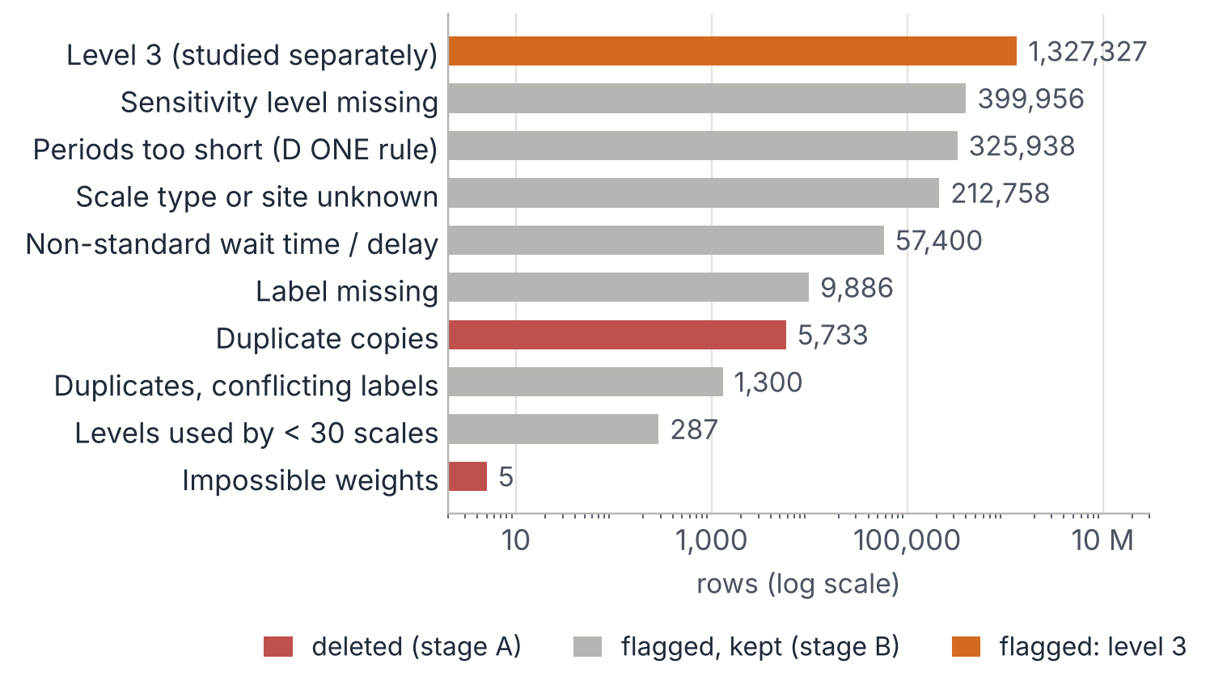
STEP 1 · DATA
What we worked with – and how we cleaned it
7.6 M
18,455
weighings in measurements.csv
scales – type, box, site and item weight for most of them
16 weeks
69%
1 March – 20 June 2022
of the rows enter the KPI analysis
So: delete only what is broken (5,738 rows). Flag the rest and keep it: a flagged row still counts for the weight change of the next weighing and as a neighbouring pick – it just does not enter the KPIs.
Source: own analysis of the Bossard SmartBin data, 1 Mar – 20 Jun 2022 (measurements, scale metadata, D ONE preprocessing flags)
5
Notes:
Three files: the measurements – 7,596,224 weighings of 18,455 scales from 1 March to 20 June 2022 –, the scale metadata (scale type, box type, site, item weight) and D ONE's preprocessing flags. We cleaned with an explicit rule book in two stages. Stage A deletes only what cannot be used anywhere: 5,733 duplicate copies (same scale, same millisecond) and 5 physically impossible weights – exactly the rows D ONE had marked as invalid. Stage B flags rows that are unsuitable for the KPIs but keeps them, because they are still real weighings: we need them to compute the weight change of the next weighing and as neighbouring picks in the timing analysis. The largest flag is level 3 with 1,327,327 rows – we come back to it on slide 14. Four checks shaped the rules: 1,300 duplicate groups carry different labels, so their outcome is unknown; D ONE's 'relevant section' rule – at least 20 weighings over at least 5 days – holds for 100% of the sections; rows with an empty wait-time setting behave like standard rows and are kept; and 985 scales have no type or site. In the end 5.26 million rows (69%) enter the KPI analysis, and every excluded row is exported with its reason. The unit of analysis is one scale on one sensitivity level. We summarise with the median scale, the 'typical scale', so that every scale counts once – pooling all rows would let the noisiest scales dominate.

Slide 6
STEP 2 · OBSERVE · POWER BI
First look: what each sensitivity level does
WHAT WE SAW
Lower levels help – less than expected. Median fraction of 20 kg scales: 0.92 on level 8, 0.70 on level 1 (6 kg: 0.74 → 0.50).
TOO_FEW per week stays low on every level (at most 0.8 for the typical scale) – even on level 1, where half of the changes are missed (slide 13).
Huge spread within every level – something other than the setting drives the result.
Careful: different scales on different levels – a description, not yet a cause.
POWER BI DASHBOARD A
KPIs by sensitivity level (page 1): median TOO_MANY fraction, TOO_FEW per week and share of scales per fraction class, for each level – slicer 6 kg / 20 kg
Insert a screenshot of the Power BI page here and delete this box.
Source: own analysis of the Bossard SmartBin data, 1 Mar – 20 Jun 2022; Power BI report on the pipeline's export (one row = one scale on one level)
6
Notes:
[Presenter: show the 20 kg view first, then switch the slicer to 6 kg.] This is our observation dashboard in Power BI. It is built on an export of our pipeline in which one row is one scale on one sensitivity level, so every ratio is computed per scale before it is summarised – otherwise the busiest scales would dominate. What it shows: lowering the setting improves the median TOO_MANY fraction, but much less than one would expect – on 20 kg scales from 0.92 on level 8 to 0.70 on level 1, on 6 kg scales from 0.74 to 0.50. TOO_FEW per week stays far below Bossard's limit of 2 on every level – even on level 1, where the same scales miss half of their changes (slide 13): a weekly count of misses hides how many changes are missed. And within every level the scales spread over the whole range from 0 to 1. One caution: this view compares different scales on different levels and periods. It describes; it does not prove cause. The causal effect of the setting follows on slide 13.

Slide 7
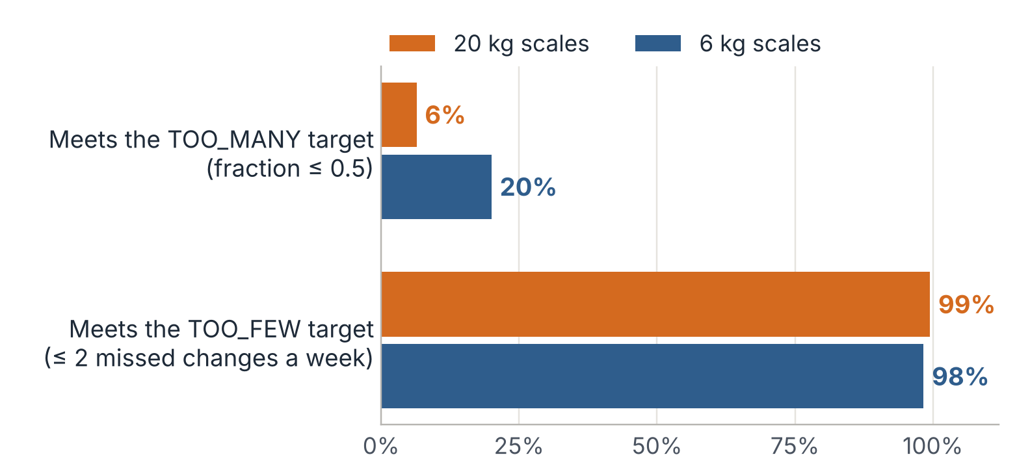
STEP 3 · ANALYSE · FINDING 1
The problem is one-sided
13.5 vs 1.5
empty wake-ups vs. real picks caught per week – typical 20 kg scale on level 8
8.5 vs 3.0
the same for the typical 6 kg scale
So: the question is not how to balance two targets – it is how far the sensitivity can go down before real changes are missed.
Source: own analysis of the Bossard SmartBin data, 1 Mar – 20 Jun 2022; level 8 (factory default), typical scale = median
7
Notes:
At the factory default, level 8, 99% of the 20 kg and 98% of the 6 kg scales meet the TOO_FEW target – but only 6% and 20% meet the TOO_MANY target, and 71% of the 20 kg scales are even above the alarm level of 0.8. The typical 20 kg scale wakes up empty 13.5 times a week and catches 1.5 real picks; the typical 6 kg scale 8.5 and 3.0. So this is not a case of two equally violated targets. The question is how far the sensitivity can be lowered before real changes are missed. One warning that will matter later: the TOO_FEW target is so loose that it is met even by scales that miss half of their changes.

Slide 8
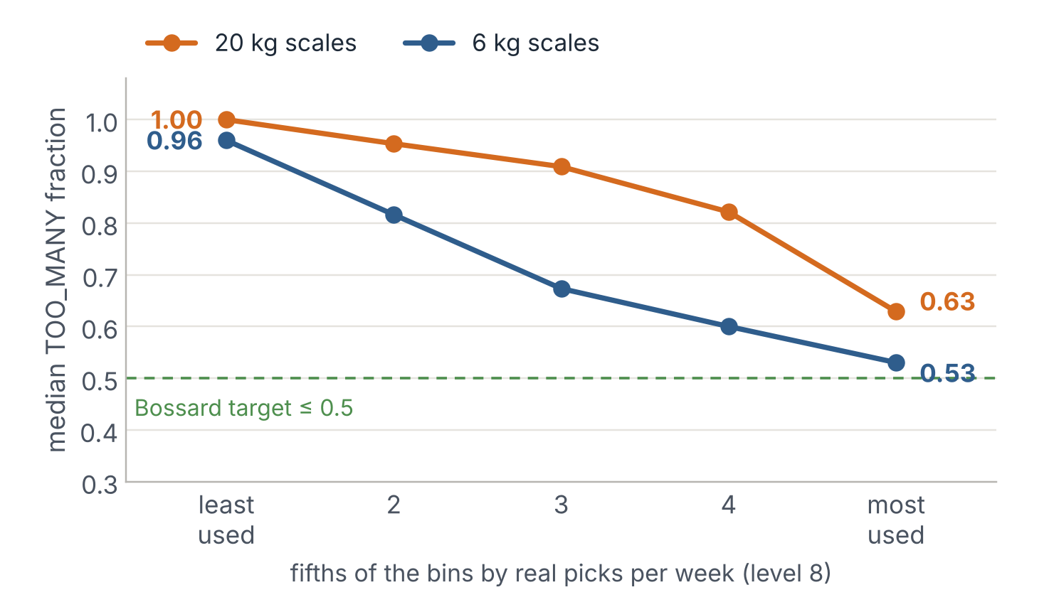
FINDING 2
The TOO_MANY fraction is the wrong compass
1.00 vs 0.63
median fraction of the least- vs. the most-used fifth of the 20 kg bins – same setting
−97% / −90%
empty wake-ups / caught picks when the same 20 kg scales go from level 8 to 1 – the fraction falls by only 0.23
So: judge a scale by its empty wake-ups per week and the share of changes it misses – KPI 2.0: ≤ 7 empty wake-ups a week · ≤ 10% of changes missed · ≤ 2 TOO_FEW a week.
Source: own analysis of the Bossard SmartBin data, 1 Mar – 20 Jun 2022; 'when a measure becomes a target, it ceases to be a good measure' (Strathern, 1997)
8
Notes:
The TOO_MANY fraction divides two numbers: empty wake-ups by all automatic weighings. A bin that is rarely used has few real weighings in that denominator, so every empty wake-up counts heavily. On level 8, the least-used fifth of the 20 kg bins has a median fraction of 1.00, the most-used fifth 0.63; the rank correlation between real picks per week and the fraction is −0.82 on 20 kg and −0.67 on 6 kg scales. The typical 20 kg bin is picked only half as often as a 6 kg bin. If a typical 6 kg bin were picked as rarely, its fraction would be about 0.85 instead of 0.74 – roughly 60% of the gap between the two scale types. Second, the setting moves both numbers. When the same 20 kg scales go from level 8 to level 1, their empty wake-ups fall by 97%, but their caught picks fall by 90% as well, and the fraction improves by only 0.23. A scale on level 1 has a 'good' fraction mainly because its sensor is practically switched off. This is Goodhart's law in action – when a measure becomes a target, it ceases to be a good measure (Strathern, 1997). We therefore propose KPI 2.0: empty wake-ups per week, at most 7, because battery, radio and cloud pay per weighing, not per ratio; the share of real changes missed, at most 10%, because that is the service the customer receives; and Bossard's own floor of at most 2 TOO_FEW per week.

Slide 9
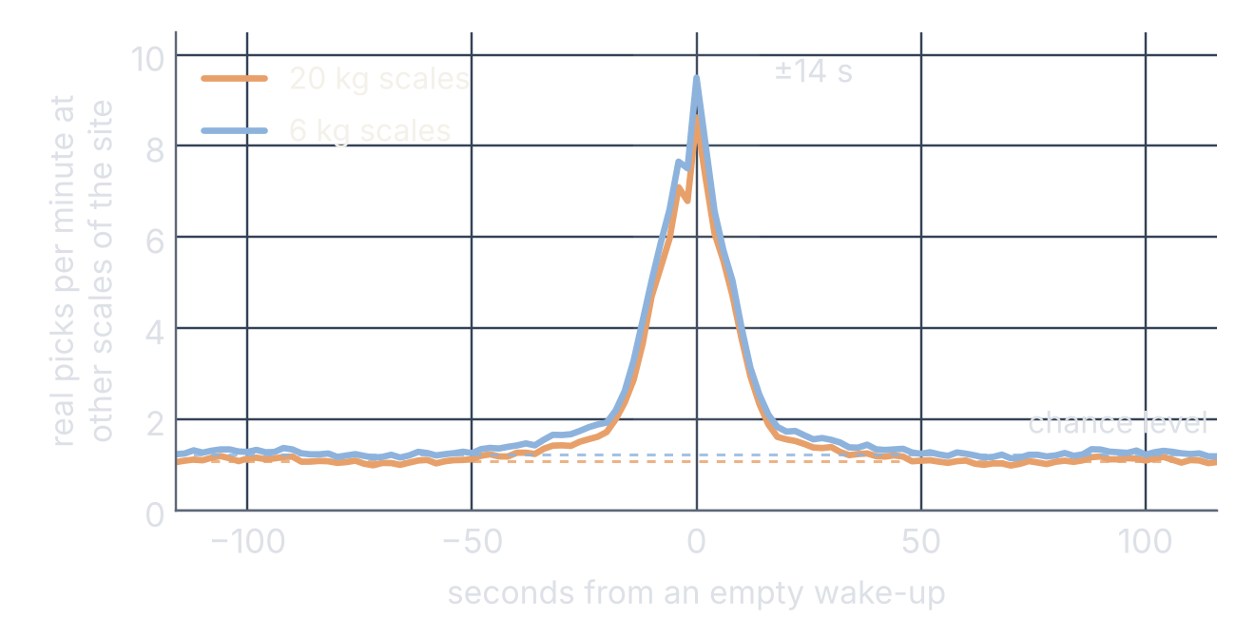
THE KEY INSIGHT
Almost half of the empty wake-ups coincide with a pick at the same site
48%
42%
20 kg scales
6 kg scales
of the empty wake-ups come within ±14 seconds of a real pick at another scale of the same site – beyond what chance explains. At that moment, picks nearby jump from about 1 to about 9 per minute.
Empty wake-ups also follow the working day like real picks (hourly profiles: r = 0.99) – only about 2.5% happen at weekends. They go with activity on the site, not with idle hours.
Method: event coincidence analysis (Donges et al., 2016), control window 60–88 s after the wake-up. Source: own analysis of the Bossard SmartBin data, 1 Mar – 20 Jun 2022
9
Notes:
This is the most important observation of the project. For every empty wake-up we looked for a real pick at another scale of the same site within a short time window – an event coincidence analysis (Donges et al., 2016). If both were unrelated, the picks would be spread evenly over time. Instead they pile up sharply at the moment of the empty wake-up: from about 1.1 to about 8.6 per minute on 20 kg scales. The peak is about ±14 seconds wide. On level 8, 60% of the empty wake-ups of 20 kg scales have a pick at another scale of the site within ±14 seconds; in a control window one minute later only 22% do – that is the chance level of a busy site. Beyond chance, 48% (20 kg) and 42% (6 kg) of the empty wake-ups are linked to picking at the same site – 45% across both scale types; the scale's own echo after its own pick explains only 1–3%. A second test points the same way: empty wake-ups follow the working day like real picks – the hourly profiles correlate at r = 0.99 – and only about 2.5% of them happen at weekends, so switching the sensor off at night or at weekends would not help (appendix). What the data cannot show: the same peak appears around real picks, because people pick several bins in a row, and machines working in shifts would show the same daily rhythm. So we cannot separate vibration travelling through the rack from a worker touching the bin or from a pick too small to count. A short on-site test with an accelerometer or a damping pad would settle it. The other half of the empty wake-ups cannot be attributed to picking at the same site and remains unexplained.

Slide 10
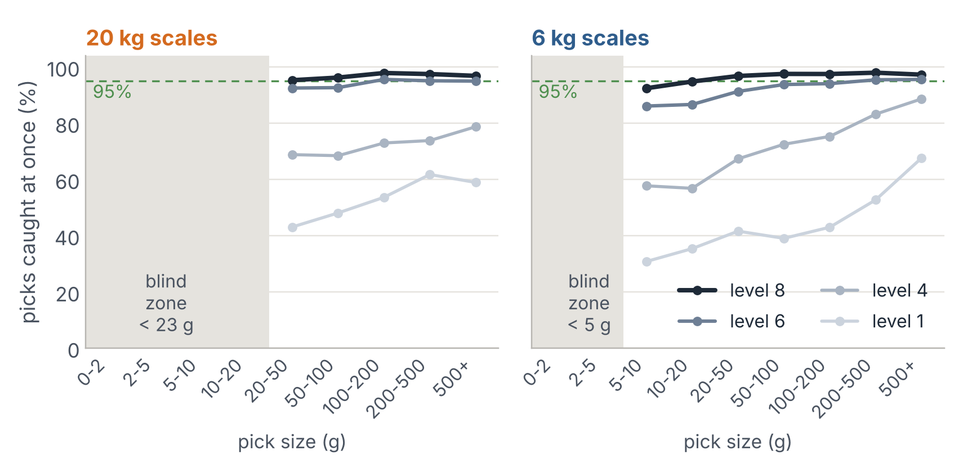
FINDING 3
Every scale has a blind zone
Below ≈ 23 g (20 kg) and ≈ 5 g (6 kg) a pick is mostly invisible to the scale.
Level 8 catches ≥ 95% of the picks from 20 g up. Levels 1–5 never reach 95% for any pick size.
53% of the 6 kg scales have a typical pick below 25 g – only 2% of the 20 kg scales do.
So: small parts belong on 6 kg scales – and a 6 kg scale cannot go as low as a 20 kg scale.
Source: own analysis of the Bossard SmartBin data, 1 Mar – 20 Jun 2022; pick size = weight drop since the previous weighing
10
Notes:
The cloud labels a weighing as 'changed' only if the weight changed by more than a significance threshold. The threshold is not documented, so we estimated it from the data as the lower end of the changes reported as missed (the 5th percentile of the TOO_FEW pick sizes): about 23 g on 20 kg scales and 5 g on 6 kg scales. Below it a pick is largely invisible: it is labelled TOO_MANY when the sensor wakes up and is never reported when it does not. Above it, detection depends on the pick size and the setting. The chart shows the share of picks the sensor caught at once, by pick size. On level 8, picks from 20 g upwards are caught in at least 95% of cases on both scale types; levels 1 to 5 do not reach 95% for any pick size. This matters for the recommendation: 53% of the 6 kg scales have a typical pick below 25 g – their median pick is 22 g, against 127 g on 20 kg scales. They work right at the edge of what a scale can see, so their sensitivity cannot go as low as that of a 20 kg scale. And parts that are picked in amounts below about 25 g belong on 6 kg scales.

Slide 11
FINDING 4 · POWER BI
Where a bin stands matters more than what is in it
0.61–0.97
median fraction of the middle 80% of the 20 kg sites (6 kg: 0.48–0.92)
42% / 40%
POWER BI DASHBOARD B
of the differences between scales lie between sites – stable in two random halves (r = 0.76 / 0.85)
Sites × sensitivity (page 2): median TOO_MANY fraction per site on level 8 and how the sites react on the other levels – one small chart per level, no dual axis
10 sites
hold 47% / 41% of all coupled empty wake-ups
Insert a screenshot of the Power BI page here and delete this box.
Source: own analysis of the Bossard SmartBin data, 1 Mar – 20 Jun 2022; intraclass correlation (Shrout & Fleiss, 1979), permutation test p ≤ 0.001
11
Notes:
[Presenter: show the Power BI page 2 – median TOO_MANY fraction per site, one small chart per level.] The site shows the largest differences in the data. Among 20 kg scales on level 8, the middle 80% of the sites range from a median fraction of 0.61 to 0.97 (6 kg: 0.48 to 0.92). The differences are real and stable: 42% (20 kg) and 40% (6 kg) of the variation between scales lies between sites – the intraclass correlation (Shrout & Fleiss, 1979); a permutation test with 999 shuffles of the site labels gives p ≤ 0.001; two random halves of the scales of each site agree closely (split-half r = 0.76 and 0.85); and the effect remains when we account for how busy the bins are. The coupling of slide 9 is concentrated as well: ten sites hold 47% (20 kg) and 41% (6 kg) of all coupled empty wake-ups. Possible reasons are the construction of the racks, machines nearby and the way people work. Bossard knows the site of every scale, but how a site behaves only shows in its data – and the data contain the site, not the rack.

Slide 12
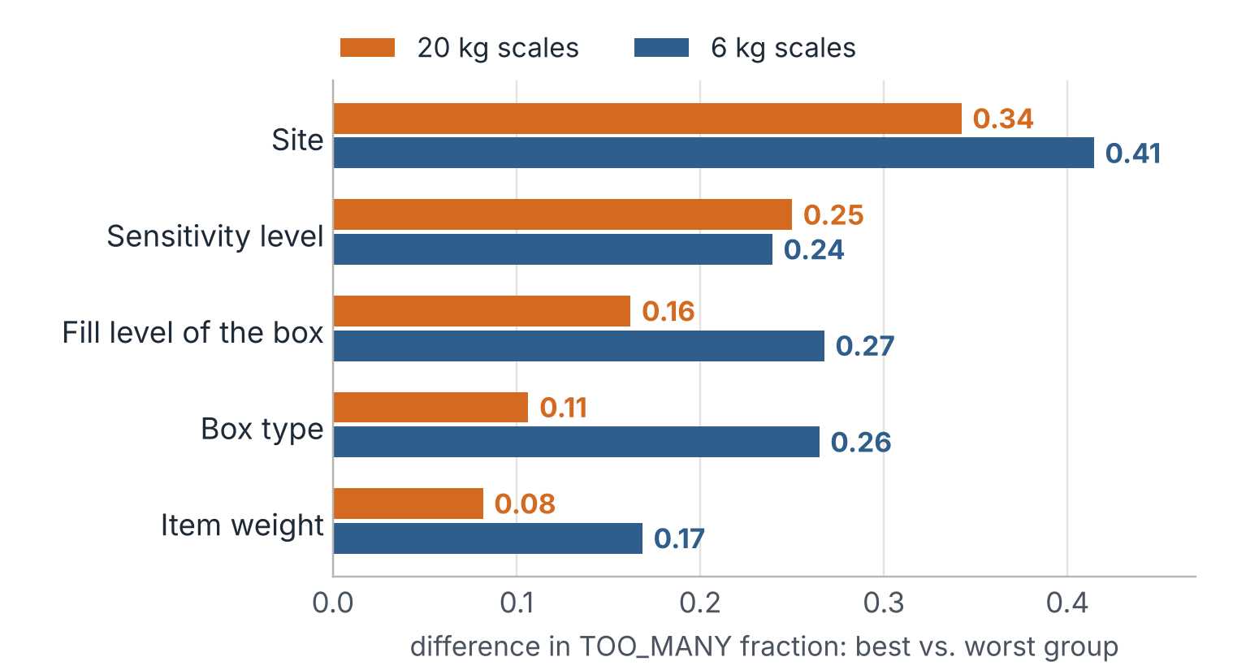
ANSWER TO QUESTIONS 1 AND 2
What matters – and what hardly does
Hardly matters
20 kg: box type (0.11) and item weight (0.08). Both types: a fuller box on the same scale (−0.045 / −0.027).
Matters
Site and usage (0.34–0.43) and the setting – the only lever Bossard controls remotely. On 6 kg scales box type (0.26) and item weight (0.17) differ too.
How to read it: median TOO_MANY fraction of the best vs. the worst group of each parameter, all on level 8 except the setting (scales with ≥ 5 automatic weighings); sites with ≥ 20 scales: 10th vs. 90th percentile; usage: least- vs. most-used fifth (slide 8).
Source: own analysis of the Bossard SmartBin data, 1 Mar – 20 Jun 2022; Shapley decomposition in the appendix (Grömping, 2006)
12
Notes:
The answer to questions one and two. We compared the parameters by a simple measure: how far apart are the best and the worst group? To keep the setting out of the comparison, all parameters except the sensitivity are compared on level 8 only; for sites we use the 10th and 90th percentile of the site medians, so that a few tiny sites do not dominate. On 20 kg scales the site moves the fraction most (0.34), followed by the sensitivity level (0.25) and the fill level of the box (0.16); box type (0.11) and item weight (0.08) come last. On 6 kg scales the site also leads (0.41), followed by the fill level (0.27), box type (0.26) and the sensitivity (0.24). Usage – the least- vs. the most-used fifth of the bins on slide 8 – spreads about as much as the site. Two numbers need care. The fill-level difference almost disappears when the same scale changes its fill level: −0.045 on 20 kg and −0.027 on 6 kg scales, over all scales that changed their weight bin – nearly empty boxes are mostly rarely used boxes. (D ONE's subset 'relevant for weight analysis' shows larger values, but it was selected on scales where something changes, that is, on the outcome.) And on 6 kg scales only two box types are common, and they sit at different sites; item weight also differs more there. Verdict: on 20 kg scales box type and item weight hardly matter; on 6 kg scales they matter less than site and usage. The site, the usage and the setting matter most. Of these, the setting is the only lever Bossard can change remotely – how strong it is, we measure on the next slide. A Shapley decomposition of the explained variance in the appendix ranks the site first as well; it gives the setting a small share, partly because almost all data come from level 8.

Slide 13
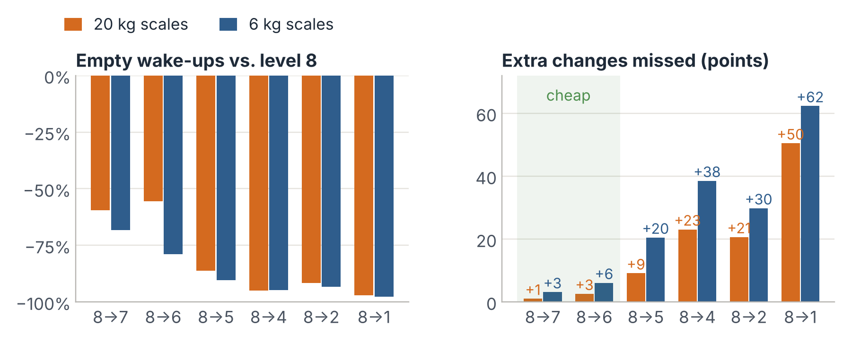
THE SETTING · BEFORE AND AFTER
Same scale, before and after: the first steps are cheap
In April Bossard moved 7,846 scales away from level 8 – a natural experiment. Each scale is compared with itself before the switch and with scales that stayed on 8.
−59% / −68%
empty wake-ups for one step, 8 → 7 (20 kg / 6 kg) …
+1 / +3 pts
… for this many more changes missed
Below level 6 the misses climb steeply. 6 kg scales react more strongly – they behave like a different instrument.
So: the setting works and the first step is cheap – how far a scale can go depends on the scale.
Method: difference-in-differences (Angrist & Pischke, 2009), fixed-effects Poisson, bootstrap intervals. Source: own analysis of the Bossard SmartBin data, 1 Mar – 20 Jun 2022
13
Notes:
Comparing different scales on different levels cannot show what the setting itself does, because the levels were not assigned at random. But in April Bossard moved 7,846 scales away from the default. We compared each of them with itself before the switch, and subtracted the change of a stable group of scales that stayed on level 8 over the same weeks – a difference-in-differences design (Angrist & Pischke, 2009). Counts per week come from a fixed-effects Poisson model; the intervals are 95% bootstrap intervals over scales. The result: the setting is powerful. One step, from 8 to 7, removes about 59% (20 kg) and 68% (6 kg) of the empty wake-ups and costs only 1 and 3 percentage points of missed changes. Below level 6 the price rises steeply: from 8 to 5 the scales miss 9 (20 kg) and 20 (6 kg) points more; on level 1 half or more of all changes are missed. The 20 kg estimates are less precise – for 8 → 6 the interval runs from about −24% to −67%. And Bossard seems to have switched some busy scales first: their empty wake-ups rose in the weeks before the switch (appendix), so part of the drop may be a return to normal. A careful reading of the first steps is therefore 'roughly half to two thirds fewer empty wake-ups'. The 6 kg scales react more strongly in both directions: the same step from 8 to 6 removes 56% of the empty wake-ups on 20 kg scales but 79% on 6 kg scales. Whether a level means the same vibration threshold on both hardware versions is not documented – we treat them as two different instruments and set them separately.

Slide 14
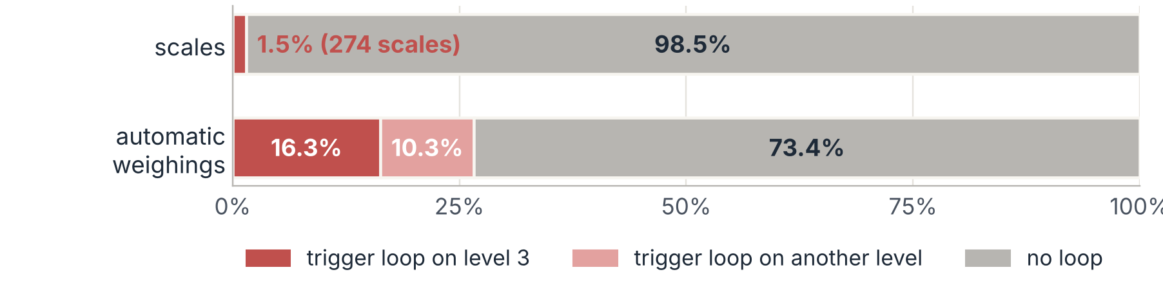
A DEFECT, NOT A SETTING
1.5% of the scales caused 27% of the automatic weighings
274 scales were caught in a trigger loop: 219 on level 3 – a quarter of the scales in its April trial – and 59 on other levels (4 on both).
The signature
The detector
The cost
A wake-up every ~90 s – the wait time (60 s) plus the delay (30 s) – day and night: 670 a day for the typical looping level-3 scale.
More than half of the wake-ups within 2 min of the previous one and more than 20 a day, judged over ≥ 5 days. Runs every day.
With the case's battery assumption, a level-3 loop empties a five-year battery in about 6 weeks (about 14 weeks for the slower loops on other levels).
So: repair it, don't tune it – keep level 3 off the menu and send looping scales to service.
Source: own analysis of the Bossard SmartBin data, 1 Mar – 20 Jun 2022; battery model of the case: a weighing ≈ 2 s at ≈ 3,000 × sleep power
14
Notes:
The case description advises ignoring level 3. The data show why – and that the problem is not only level 3. Level 3 was used only during a four-week trial in April 2022: 907 scales ran on it, and together they woke up about 146 (20 kg) and 162 (6 kg) times per scale and day – the same scales on level 8 woke up about 11 to 12 times a day. Most of these wake-ups come in a loop: the scale wakes up, weighs and wakes up again about 90 seconds later – exactly the minimum wait time of 60 seconds plus the measurement delay of 30 seconds – day and night. We wrote a simple detector: a scale counts as looping on a level if more than half of its wake-ups follow the previous one within 2 minutes and it wakes up more than 20 times a day, judged over at least 5 days. It finds 274 scales: 219 on level 3 – about a quarter of the 833 level-3 scales it could judge – and 59 on other levels, mostly on level 8 (a few loop on both). Together they produced 27% of all automatic weighings in the data, although they are only 1.5% of the scales; the loops outside level 3 alone produced 10%. The typical looping level-3 scale wakes up 670 times a day. With the case's assumption that a weighing costs about 3,000 times the sleep power for about two seconds, such a scale would empty a battery designed for five years in about 6 weeks; the slower loops on other levels in about 14 weeks. A different sensitivity is not the fix for a loop: it is a defect. Level 3 should stay off the setting menu until the firmware is fixed, and the detector should run every day to send looping scales to service. The looping scales are left out of the policy savings that follow.

Slide 15
ANSWER TO QUESTION 3
The right setting is not in the master data – each scale has to learn it
1
2
3
What Bossard knows in advance – box type, item weight – matters little next to site and usage.
What matters – how busy a bin is, its neighbours, its pick size, how its site behaves – only shows once the scale runs.
But every scale reports what we need, every week: how often it woke up for nothing, and how many of its changes were missed.
So each scale finds its own level from its own results – with a simple rule that anyone can audit.
15
Notes:
This is the answer to question three, and it follows from everything before. First: what Bossard knows about a bin before installing it – the box type, the item weight – hardly matters on 20 kg scales and matters less than site and usage on 6 kg scales. Second: what does matter – how often the bin is used, what happens on the rack next to it, how small the typical pick is, and how its site behaves – only shows once the scale is running. Bossard knows the site, but not how it will behave. That is why a lookup table is the wrong tool: in our simulation, a table by pick-size class chose the same setting as one level for everybody for 95 to 99% of the scales. Third, and this is the good news: every scale already reports exactly what is needed, every week – how often it woke up for nothing, and how many of its changes were only found by a later check. So instead of guessing the setting from the master data, we let each scale find its level from its own results, with a simple rule that anybody can audit. We deliberately chose a transparent rule over a machine-learning model: it is easy to explain, to check and to trust, and it needs no inputs that Bossard does not already have.

Slide 16
RECOMMENDATION
Flag, tune, watch
FLAG
TUNE
WATCH
Repair what no setting can fix
Let every scale learn its level
Keep the service level visible
Run the loop detector every day; send looping scales to service.
Take level 3 off the menu until the firmware is fixed.
Start every scale on 7 instead of 8.
Every 2 weeks: one step less sensitive if > 7 empty wake-ups a week and ≤ 5% missed; one step more sensitive if > 10% missed or > 2 TOO_FEW a week.
Same rule, 6 kg and 20 kg monitored apart.
Report KPI 2.0 per scale (Power BI).
Keep the 24 h check – it finds 91% of the detected misses.
Watch list: 10% of the scales produce 55% / 36% of all misses → 12 h check or a higher level.
loops caused 27% of all automatic weighings – no trade-off involved
−61% (20 kg) / −55% (6 kg) weighings
misses found within 1–2 days; the miss limit sets the trade-off
At the customer site: parts picked in amounts below ≈ 25 g go on 6 kg scales · damping test at the 10 sites with the most coupled wake-ups
Source: own analysis of the Bossard SmartBin data, 1 Mar – 20 Jun 2022; simulation of every scale's own history, scales in a trigger loop left out
16
Notes:
Our recommendation has three parts. FLAG – repair what no setting can fix. The loop detector runs every day; looping scales go to service, and level 3 stays off the setting menu until the firmware is fixed. In the data the loops caused 27% of all automatic weighings – most of them during the level-3 trial in April, but 59 scales also looped on other levels. Repairing a loop involves no trade-off with missed changes. TUNE – let every scale learn its level. Every scale starts on level 7 instead of 8: on the same scales, this one step removed 59 to 68% of the empty wake-ups for 1 to 3 points more misses. Then each scale is checked every two weeks: if it woke up empty more than 7 times a week and missed at most 5% of its changes, it goes one step less sensitive; if it missed more than 10% of its changes or had more than 2 TOO_FEW a week, it goes one step more sensitive. 6 kg and 20 kg scales run the same rule but are monitored separately, because they are different instruments. WATCH – keep the service level visible. KPI 2.0 is reported per scale in a dashboard; the existing 24-hour idle check stays as the safety net – it finds 91% of all detected misses (TOO_FEW), usually one to two days after the last weighing; and a watch list covers the few scales where misses concentrate: 10% of the scales produce 55% (20 kg) and 36% (6 kg) of all TOO_FEW. They get a 12-hour check or a higher level. We do not recommend a nightly check for every scale: it would cost up to 7 weighings per scale and week – about a third of the savings. The miss limit of 10% is a management decision: a lower limit for critical parts keeps more scales sensitive and saves less. At the customer site, two actions help: parts that are picked in amounts below about 25 grams go on 6 kg scales, and damping pads are tested at the ten sites that hold almost half of the coupled empty wake-ups.

Slide 17
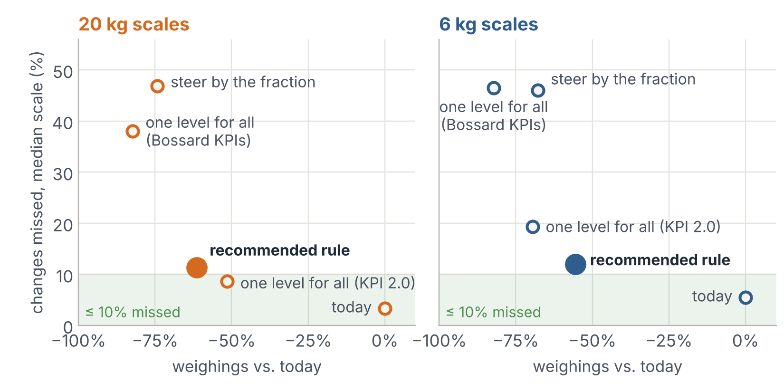
RESULT
What it adds up to
−61% / −55%
weighings of the 20 kg / 6 kg scales without a loop
≈ 2.1 million
fewer weighings per week if the 110,000 installed scales behaved like ours (≈ 19 per scale; illustrative)
11–12%
of the changes found late by the 24 h check – just above the 10% limit (simulated today: 3–5%)
No policy brings the typical scale to Bossard's 0.5 fraction (best: 0.67 / 0.59). Scales meeting KPI 2.0: 4% → 26% (20 kg), 7% → 18% (6 kg). A simulation: compare the policies, don't read the numbers as forecasts.
Source: own analysis of the Bossard SmartBin data, 1 Mar – 20 Jun 2022; each scale's level-8 history × causal rate ratios, 5 replications, 16 weeks
17
Notes:
What does it add up to? We simulated each policy on every scale's own history: the scale keeps its behaviour on level 8, and the causal effects of slide 13 translate it to the other levels; every rule was run five times. For scales without a loop, the recommended rule cuts the weighings by 61% (20 kg) and 55% (6 kg) – about 19 weighings per scale and week; if the 110,000 installed scales behaved like the ones in our data, that would be roughly 2.1 million per week – an illustration, not a forecast. The price: the typical scale misses 11 to 12% of its changes at first, instead of 3 to 5% in the simulated status quo – just above the 10% limit of KPI 2.0, because the rule keeps testing the next lower level. A stricter step-down threshold would miss less and save less; the pilot should tune it. Missed changes are not lost – the 24-hour check finds most of them, usually within one to two days. The share of scales that meet KPI 2.0 rises from 4% to 26% (20 kg) and from 7% to 18% (6 kg), and a scale changes its setting about once a month. The battery life of a typical scale grows by only 5 to 8%, because sleep dominates its energy budget – the big gains are on the radio network, the cloud and ARIMS, and on the looping scales. Why not the alternatives? The best single level for Bossard's KPIs still leaves most scales outside Bossard's targets and misses 38 to 46% of the changes. One level tuned for KPI 2.0 saves less on 20 kg scales and misses 19% on 6 kg scales. A rule that steers by the fraction pushes 45% of the 20 kg scales to level 1 and misses 46 to 47% of the changes. And no policy brings the typical scale to Bossard's fraction target of 0.5. Caution: the simulation is a model. It is stricter than the observed status quo and somewhat optimistic in a back-test on the real switchers, so its numbers compare policies; they are not forecasts – hence the pilot on the next slides.

Slide 18
HONESTY
What we cannot claim yet
Observational data
Misses are a lower bound
Coupling: half explained
The before/after design removes what is constant per scale and calendar effects – not events that hit only the switched scales, e.g. a busy spell just before their switch.
TOO_FEW comes only from a manual weighing. A missed pick followed by an automatic weighing counts as OK – true miss rates are higher.
Rack vibration, touching and picks below the threshold cannot be told apart in the data – and half of the empty wake-ups remains unexplained.
Site, not rack
The simulation is a model
Assumptions to confirm
The data know only the site. Neighbouring scales were inferred from timing and must be confirmed on site.
Stricter than the observed status quo and somewhat optimistic in a back-test (r = 0.31–0.68 per scale): it ranks policies, it does not forecast.
The battery model (2 s at 3,000 × sleep power), the 24 h check rule and the significance threshold were inferred; the data cover one season.
Source: own analysis of the Bossard SmartBin data, 1 Mar – 20 Jun 2022
18
Notes:
Every analysis has limits, and naming them makes the work more credible, not less. One: the data are observational. The before/after design removes everything that is constant per scale and the calendar effects, but it cannot rule out an event that happened only to the switched scales around their switch – and some of them were busier than usual just before it. Two: TOO_FEW is a lower bound of the misses, because only a manual weighing can produce it; a missed pick that is followed by an automatic weighing is labelled OK. True miss rates are therefore somewhat higher – probably for every policy, though not necessarily to the same degree. Three: the coupling analysis links about half of the empty wake-ups to picking nearby, but it cannot separate vibration through the rack from touching the bin or from picks below the threshold, and the other half remains unexplained. Four: the data know only the site; groups of neighbouring scales were inferred from timing and must be confirmed on site. Five: the policy simulation is stricter than the observed status quo and somewhat optimistic in a back-test on the real switchers – the correlation between predicted and observed fraction per scale is only 0.31 to 0.68; it ranks policies, it does not forecast. Six: the battery model, the rule of the 24-hour check and the significance threshold were inferred from the case material and the data and should be confirmed by Bossard; and the data cover one season, March to June 2022.

Slide 19
NEXT STEPS
From analysis to pilot
For Bossard
For our project (until 27 Nov)
Expected results
Repair the looping scales; take level 3 off the menu.
Pilot the rule at 5–10 sites for 8 weeks, against matched control sites.
Damping test at one of the top coupling sites.
Confirm with the firmware team: what a level means per scale type, the threshold, the 24 h check.
Work in the feedback from 23 October.
Power BI: sites page and a KPI 2.0 watch-list page.
Literature: IoT replenishment (e-Kanban), detector trade-offs.
Final deck with full speaker notes; code and report in the repository.
A rule Bossard can switch on centrally – no new hardware.
About 55–61% fewer weighings on normal scales, with about 1 in 9 changes found late – to be confirmed in the pilot.
A daily loop detector: in the data, 59 scales looped outside level 3 (10% of all automatic weighings).
Team: Erenalp Çakıroğlu – SmartBin case (data pipeline, analysis, Power BI, deck) · Nikolaos Georgantopoulos – inventory case · both decks reviewed jointly before submission.
Source: own analysis of the Bossard SmartBin data, 1 Mar – 20 Jun 2022
19
Notes:
What happens next? For Bossard, four steps. First, repair the looping scales and take level 3 off the menu – this is quick, cheap and safe. Second, pilot the rule: five to ten sites for eight weeks, each matched with a similar control site that stays on the current setting, so that the effect can be measured cleanly – the same before/after logic we used on the data. Third, an on-site damping test at one of the sites with the most coupled empty wake-ups, to find out whether the coupling travels through the racks. Fourth, three facts to confirm with the firmware team: what a sensitivity level physically means on each scale type, the exact significance threshold, and the rule of the 24-hour check. For our project, until the final submission on 27 November: work in the feedback from today; add the sites page and a KPI 2.0 watch-list page to the Power BI report; deepen the literature on IoT-based replenishment and on detector trade-offs; and complete the speaker notes, the code and the written report in the repository. The work is split as follows: Erenalp leads the SmartBin case – data pipeline, analysis, Power BI and this deck – and Nikolaos leads the inventory case; both decks are reviewed jointly before submission. Expected results: a rule Bossard can switch on centrally, without new hardware; about 55 to 61% fewer weighings on normal scales with roughly one in nine changes found late, to be confirmed in the pilot; and a daily loop detector – in the data, 59 scales looped outside level 3 and produced 10% of all automatic weighings.

Slide 20
APPENDIX A1 · POWER BI (OPTIONAL)
Data quality at a glance
POWER BI DASHBOARD C
Cleaning funnel and data quality: rows per rule (deleted vs. flagged), rows and scales per stage, share entering the KPI analysis
Optional – insert a screenshot of the Power BI cleaning page here, or delete this slide.
Source: own analysis of the Bossard SmartBin data, 1 Mar – 20 Jun 2022
20
Notes:
Optional backup: the cleaning funnel as a Power BI page (cleaning_funnel.csv in the Power BI pack).

Slide 21
APPENDIX A2
Alternatives we tested – and why we rejected them
Alternative | What we measured | Result (20 kg / 6 kg) | Verdict
One level for all (Bossard KPIs) | best single level: 4 (20 kg), 2 (6 kg) | misses 38% / 46% | reject
One level for all (KPI 2.0) | level 7 / 6 | weighings −51% / −69%; misses 9% / 19% | weaker than the rule
Table by pick size | best level per pick-size class | same level as one level for all for 95–99% of the scales | reject
Steer by the fraction (daily) | fraction rule, start 6 | misses 47% / 46% | reject (Goodhart)
Nightly check for every scale | +1 weighing per scale and night | +7 per scale and week = 33–40% of the savings | watch list instead
Quiet hours learned per site | trained Mar–Apr, tested May–Jun | avoids 6% / 6% of empty wake-ups; puts 4% / 5% of picks at risk | reject
Longer minimum wait time | 60-min vs. 1-min scales | 76% / 82% at two sites, 40% / 49% on level 1: not measurable | out of scope
Merge bursts (firmware) | one weighing per 10-min window | −13% / −14% alone, −5% / −4% on top of level 7; no misses | optional backlog
Source: own analysis of the Bossard SmartBin data, 1 Mar – 20 Jun 2022; weighings without the scales in a trigger loop
21
Notes:
Backup for questions. We tested several alternatives to the recommended rule. One level for everybody either misses too many changes (Bossard's KPIs) or saves less (KPI 2.0). A table by pick-size class ended up with the same level as one level for all for 95 to 99% of the scales. Steering by the fraction drives scales to level 1. A nightly check for every scale costs a third to 40% of the savings. Quiet hours: for every site we learned the hours of the week that held at most 1% of its real picks in March and April – a median of about 109 hours a week – and tested them on May and June: they would have avoided only 6% (20 kg) and 6% (6 kg) of the empty wake-ups while 4% and 5% of the real picks would have fallen into them. Empty wake-ups simply follow the working day. A longer minimum wait time cannot be evaluated: the scales with 60 minutes sit mostly at two sites and often on level 1, and no scale was observed with both wait times on the same level. Merging bursts – weighing once at the end of a ten-minute window instead of after every wake-up – would save 13 to 14% on its own and about 4 to 5% on top of level 7, without missing a change; about 38% of the picks would be reported about five minutes later. It needs a firmware change, so it is an optional backlog item.

Slide 22
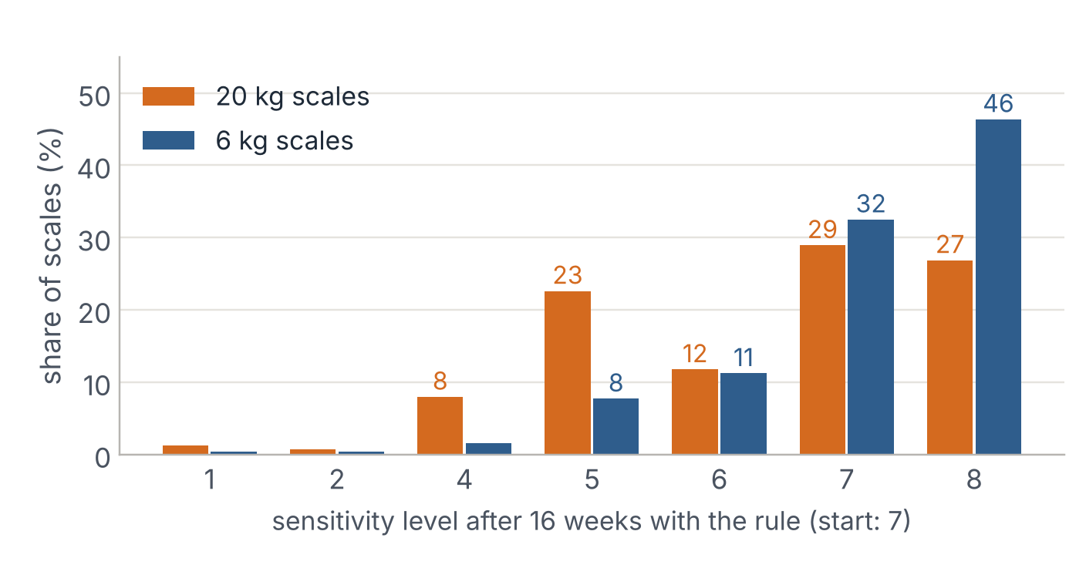
APPENDIX A3
The rule in detail – and where the scales end up
Every two weeks, per scale
Measure over the last 14 days: empty wake-ups per week (TM/wk), share of changes missed (TOO_FEW / (caught picks + TOO_FEW)) and TOO_FEW per week.
If missed > 10% or TOO_FEW/wk > 2 → one level up (more sensitive).
Else if TM/wk > 7 and missed ≤ 5% → one level down.
Else → keep the level.
Start: level 7. Range: levels 1–8 without 3. 6 kg and 20 kg are reported apart.
After 16 weeks: 56% of the 20 kg and 79% of the 6 kg scales are on level 7 or 8; almost no scale goes below 4. About one change per scale and month.
Source: own analysis of the Bossard SmartBin data, 1 Mar – 20 Jun 2022; simulation, 5 replications
22
Notes:
Backup: the exact rule and the distribution of levels after 16 simulated weeks. Many 6 kg scales return to level 8 – they handle small picks and cannot afford a lower setting.

Slide 23
APPENDIX A4
All policies compared
Policy | Weighings 20 kg | Weighings 6 kg | Missed 20 kg | Missed 6 kg | KPI 2.0 met 20 kg | KPI 2.0 met 6 kg
P0 today (level 8, simulated) | 0% | 0% | 3% | 5% | 4% | 7%
P1 one level (Bossard KPIs) | −82% | −82% | 38% | 46% | 7% | 4%
P2 table by pick size | −82% | −82% | 39% | 52% | 7% | 4%
P3 rule for Bossard's KPIs | −77% | −70% | 53% | 54% | 4% | 2%
P4 best level per scale in hindsight | −82% | −83% | 39% | 51% | 5% | 2%
P5 one level (KPI 2.0) | −51% | −69% | 9% | 19% | 20% | 12%
P6 rule, start 8 | −60% | −55% | 11% | 12% | 26% | 19%
P7 rule, start 7 (recommended) | −61% | −55% | 11% | 12% | 26% | 18%
P8 steer by the fraction | −74% | −68% | 47% | 46% | 3% | 2%
Weighings: change vs. the simulated status quo, scales without a trigger loop. Missed: median share of changes missed. KPI 2.0 met: ≤ 7 empty wake-ups a week, ≤ 10% missed, ≤ 2 TOO_FEW a week.
Source: own analysis of the Bossard SmartBin data, 1 Mar – 20 Jun 2022
23
Notes:
Backup table with all simulated policies. P4 uses hindsight and is not implementable; it shows what even a perfect fixed level per scale would achieve under Bossard's KPIs.

Slide 24
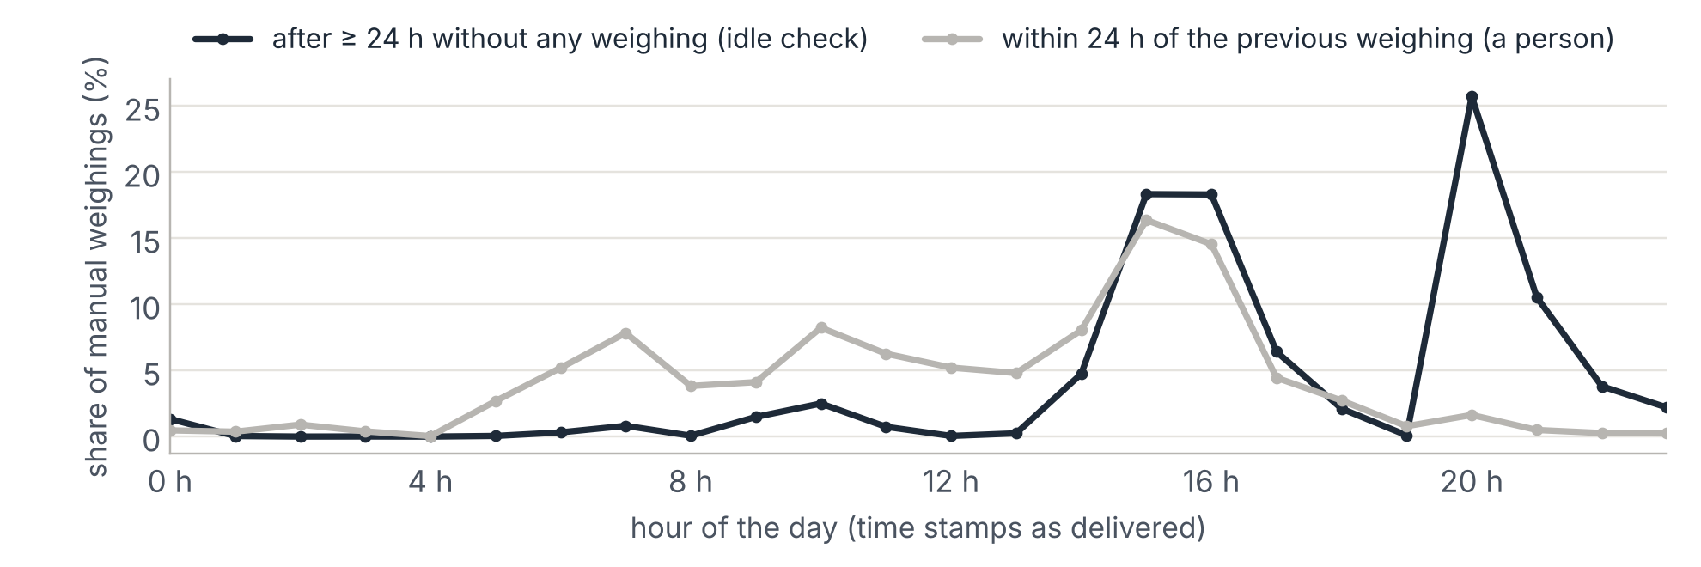
APPENDIX A5
When missed changes are found
85%
91%
26–49 h
of the manual weighings come after ≥ 24 h without any weighing – a scheduled idle check
of all TOO_FEW are found by these idle checks
after the previous weighing (5th–95th percentile): a missed change can stay invisible for up to two days
Source: own analysis of the Bossard SmartBin data, 1 Mar – 20 Jun 2022
24
Notes:
Backup: the 24-hour idle check is the safety net that makes a lower sensitivity acceptable. A TOO_FEW is therefore a delay, not a loss – and it is a lower bound of the misses.

Slide 25
APPENDIX A6
Methods in one page
Cleaning
KPIs
Stage A deletes duplicates (same scale and ms) and impossible weights. Stage B flags conflicting duplicates, missing label or level, non-standard wait/delay, missing metadata, short periods, level 3 and rare levels.
Per scale and level; typical scale = median. Missed = TOO_FEW / (caught picks + TOO_FEW).
Causal effect
Coupling
Difference-in-differences: switched scales vs. a balanced group that stayed on 8; fixed-effects Poisson rate ratios; 300 bootstrap samples over scales.
Real picks at other scales of the site within ±14 s of an empty wake-up vs. a control window 60–88 s later; beyond chance: a = (p_near − p_chance) / (1 − p_chance).
Sites
Simulation
Intraclass correlation, permutation F-test (999 shuffles), split-half reliability (200 random halves); usage-adjusted variant.
Each scale's level-8 rates (shrunk to the type mean) × causal rate ratios; 16 weeks, 5 replications; back-test on the real switchers.
Angrist & Pischke (2009); Donges et al. (2016); Shrout & Fleiss (1979); Grömping (2006)
25
Notes:
Backup: the methods behind each slide. All code is in the project repository; every number on the slides is computed from aggregated tables only.

Slide 26
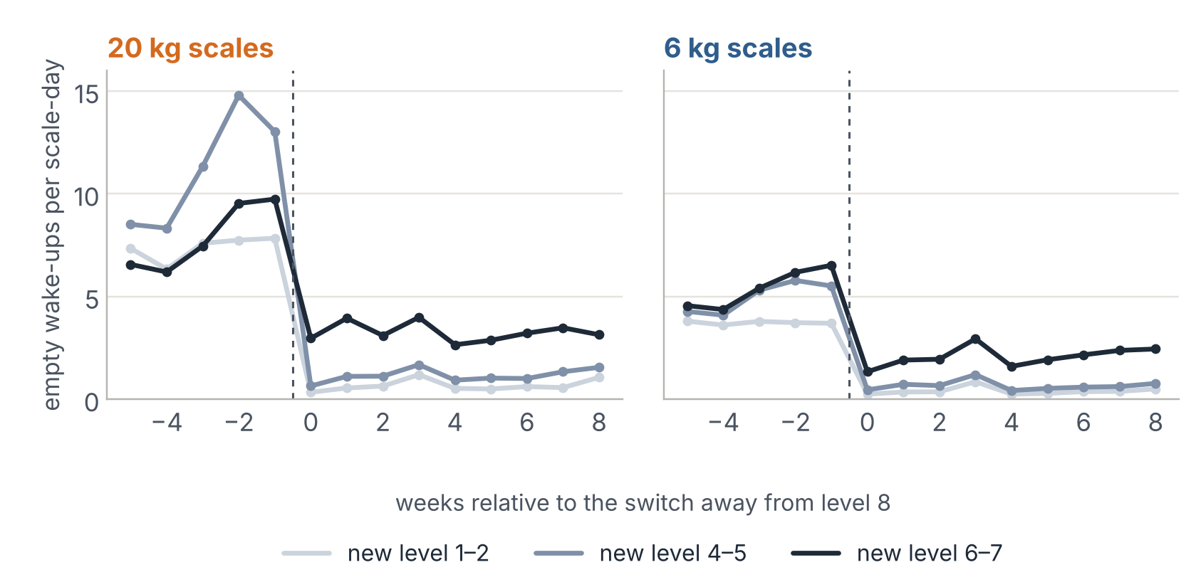
APPENDIX A7
Same scales, week by week around their switch
Empty wake-ups per scale and day collapse in the week of the switch and stay down – a far larger change than anything before it.
The weeks before the switch show some extra activity (Bossard may have switched busy scales first); the difference-in-differences on slide 13 compares with scales that stayed on 8 over the same weeks.
Source: own analysis of the Bossard SmartBin data, 1 Mar – 20 Jun 2022; event study, switched scales grouped by their new level
26
Notes:
Backup: event study supporting the difference-in-differences estimates. The bump before the switch is small compared with the drop, so it cannot explain most of it; a careful reading of the first step is 'roughly half fewer empty wake-ups'.

Slide 27
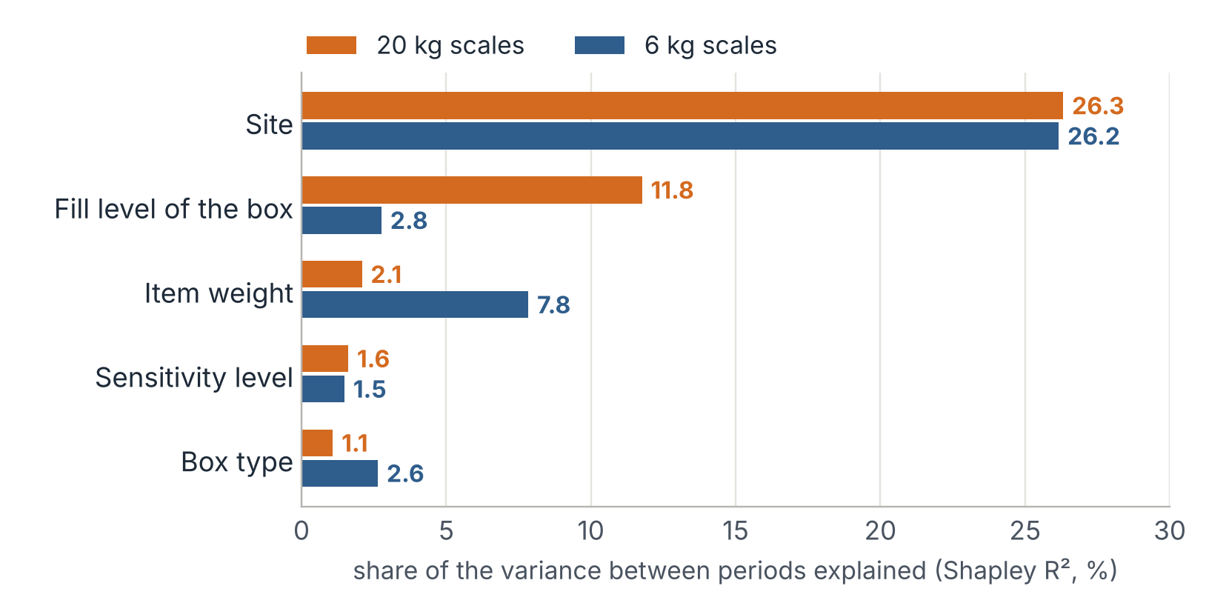
APPENDIX A8
Shapley decomposition: the site explains most
Share of the variance of the TOO_MANY fraction between periods explained by each parameter. The setting gets a small share partly because almost all data come from level 8 – its strength is measured on the same scales before and after, on slide 13.
Method: LMG / Shapley R² (Grömping, 2006). Source: own analysis of the Bossard SmartBin data, 1 Mar – 20 Jun 2022
27
Notes:
Backup: variance explained is not the strength of a lever. That is why the main slides use the spread between groups and the causal effect instead.

Slide 28
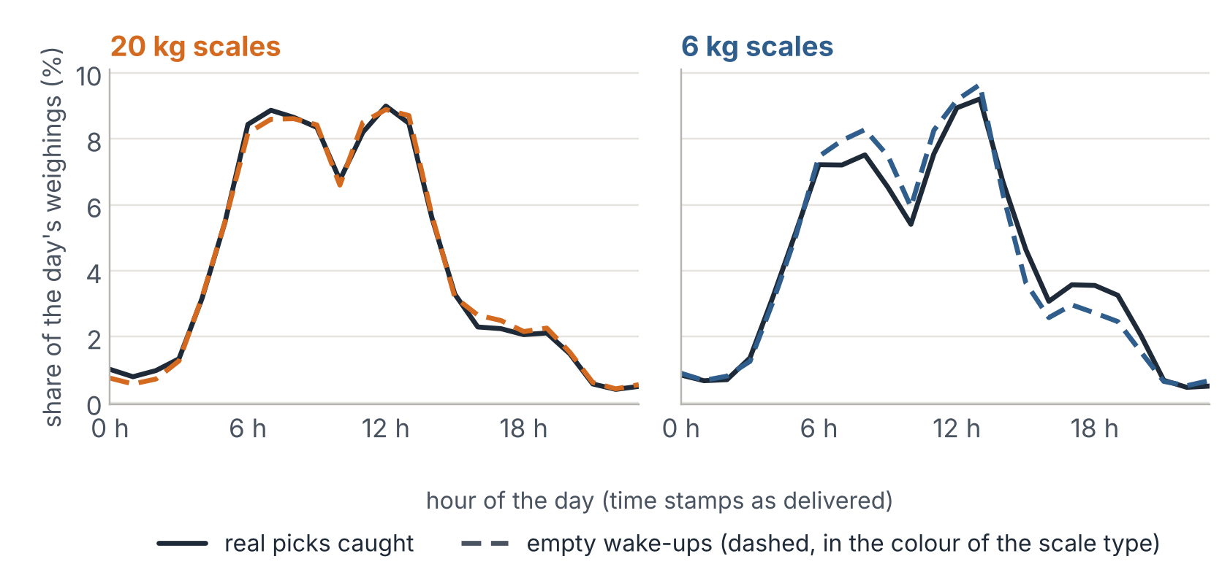
APPENDIX A9
Empty wake-ups follow the working day
Empty wake-ups (dashed) and real picks (solid) share the same daily rhythm.
Weekends: 2.4% / 2.5% of the empty wake-ups (20 kg / 6 kg).
So a night or weekend mode would not help: empty wake-ups go with activity on the site (r = 0.99).
Source: own analysis of the Bossard SmartBin data, 1 Mar – 20 Jun 2022; scales in a trigger loop left out
28
Notes:
Backup for the question 'did you check nights and weekends?'.

Slide 29
APPENDIX A10 · REFLECTION
What we learned
Surprising
Expected
The most surprising finding was not about the setting: 274 looping scales caused more than a quarter of all automatic weighings in the data.
The setting trades empty wake-ups against misses – but the first step costs almost nothing.
Hard
Next time
Labels are not ground truth: TOO_FEW is a lower bound and tiny picks are invisible. We had to estimate the threshold from the data.
Ask for rack positions and the firmware rules first – and design the pilot with control sites from day one.
Source: own analysis of the Bossard SmartBin data, 1 Mar – 20 Jun 2022
29
Notes:
Reflection for the final documentation: lessons learned, surprises and what we would do differently.

Slide 30
REFERENCES
Sources
Anastasi, G., Conti, M., Di Francesco, M., & Passarella, A. (2009). Energy conservation in wireless sensor networks: A survey. Ad Hoc Networks, 7(3), 537–568. https://doi.org/10.1016/j.adhoc.2008.06.003
Angrist, J. D., & Pischke, J.-S. (2009). Mostly harmless econometrics: An empiricist's companion. Princeton University Press.
Bossard AG. (n.d.). SmartBin Cloud. Retrieved 6 October 2026, from https://www.bossard.com/ch-en/smart-factory-logistics/systems/smartbin-cloud/
Bossard AG & D ONE Solutions AG. (2026). Smart Factory Logistics – SmartBin Cloud [Lecture slides, case description and case data]. HSLU, module Data-driven Supply Chain Management and Logistics. Confidential (NDA).
Chapman, P., Clinton, J., Kerber, R., Khabaza, T., Reinartz, T., Shearer, C., & Wirth, R. (2000). CRISP-DM 1.0: Step-by-step data mining guide. SPSS Inc.
Donges, J. F., Schleussner, C.-F., Siegmund, J. F., & Donner, R. V. (2016). Event coincidence analysis for quantifying statistical interrelationships between event time series. The European Physical Journal Special Topics, 225(3), 471–487. https://doi.org/10.1140/epjst/e2015-50233-y
Green, D. M., & Swets, J. A. (1966). Signal detection theory and psychophysics. Wiley.
Grömping, U. (2006). Relative importance for linear regression in R: The package relaimpo. Journal of Statistical Software, 17(1), 1–27. https://doi.org/10.18637/jss.v017.i01
Shrout, P. E., & Fleiss, J. L. (1979). Intraclass correlations: Uses in assessing rater reliability. Psychological Bulletin, 86(2), 420–428. https://doi.org/10.1037/0033-2909.86.2.420
Strathern, M. (1997). 'Improving ratings': Audit in the British university system. European Review, 5(3), 305–321.
30
Notes:
All sources cited on the slides. Case data are confidential and used under the module NDA.

